Slide 1
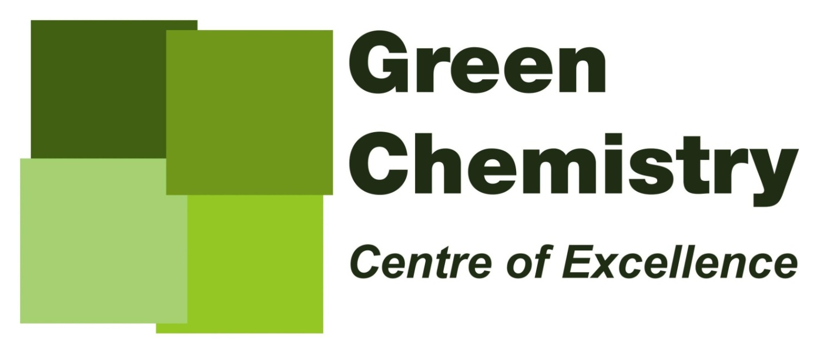


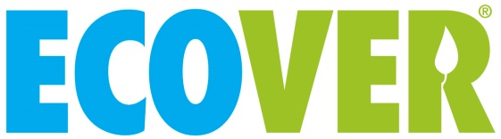
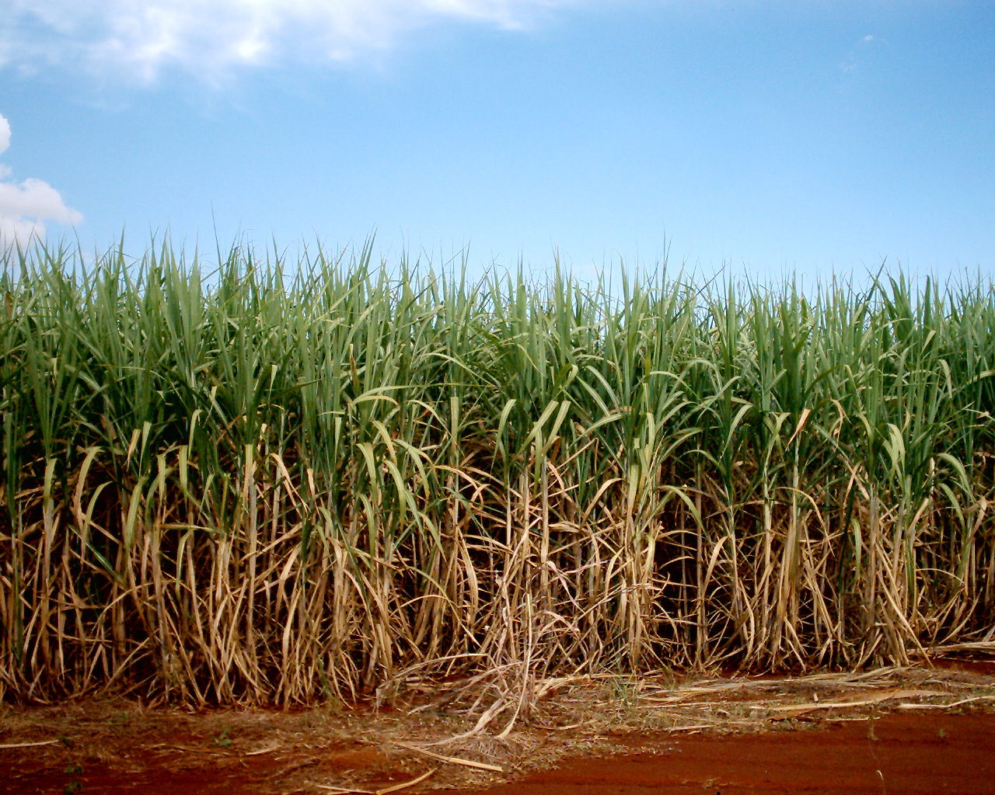
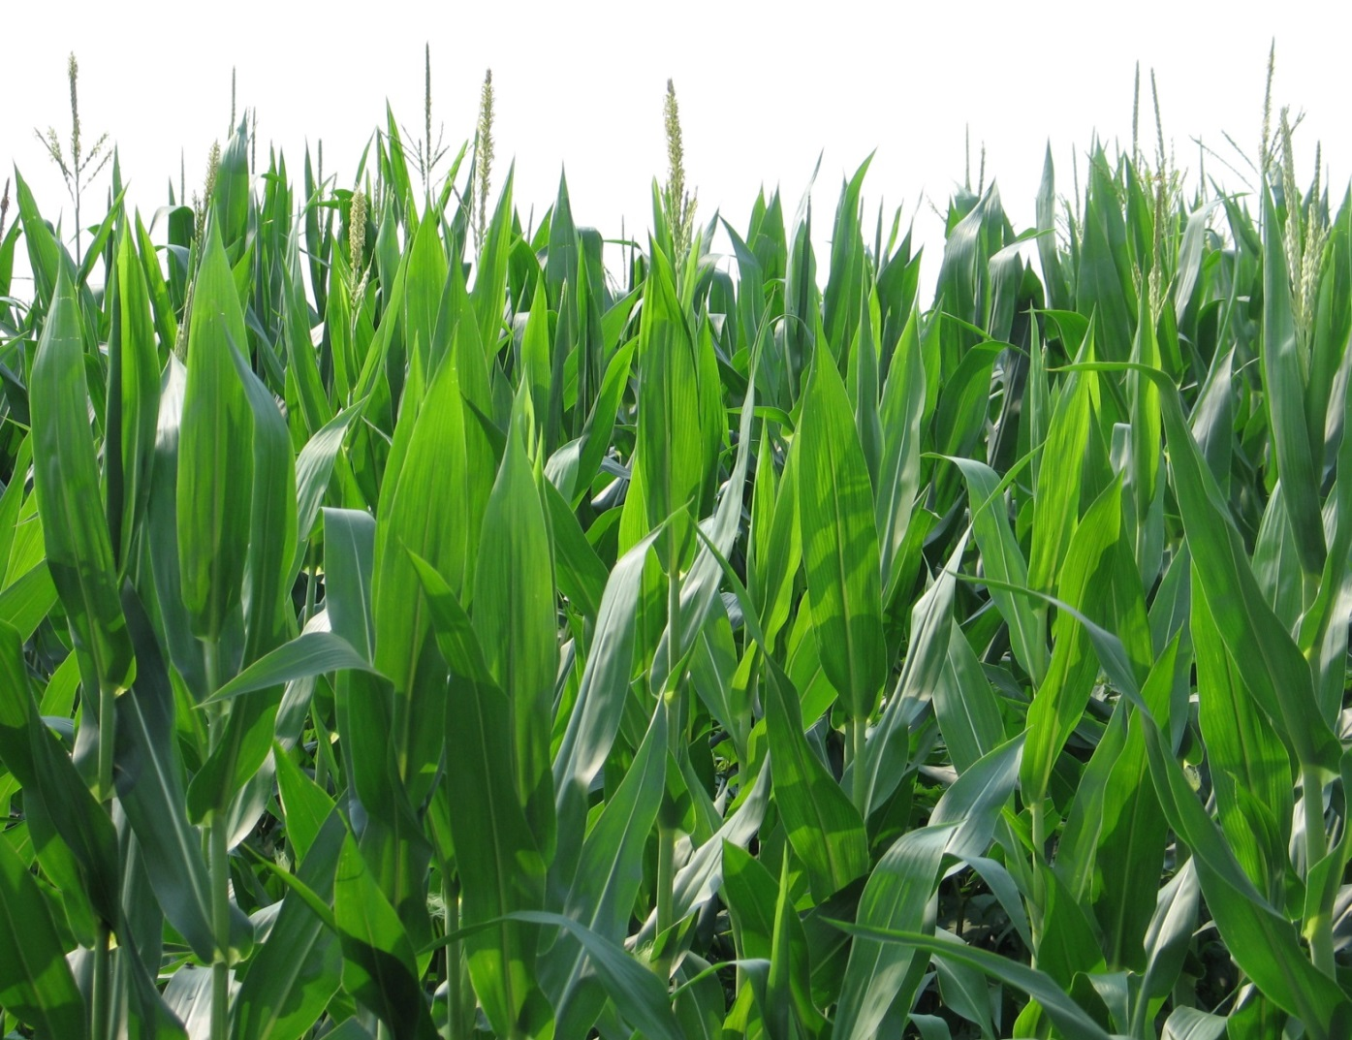
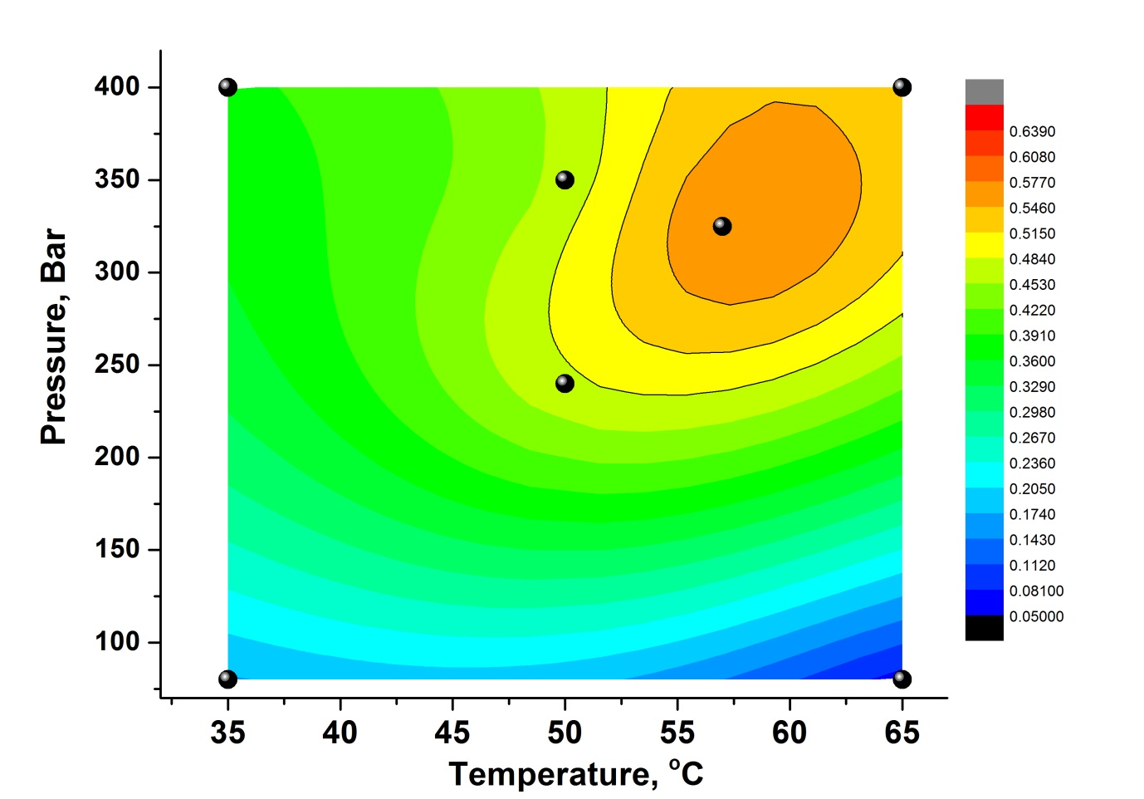
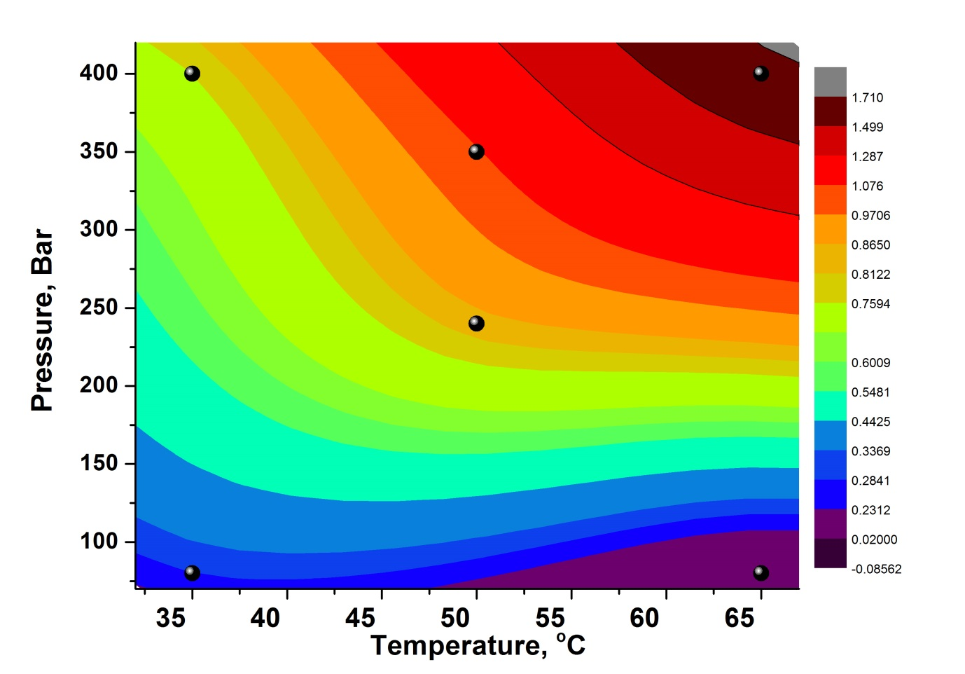
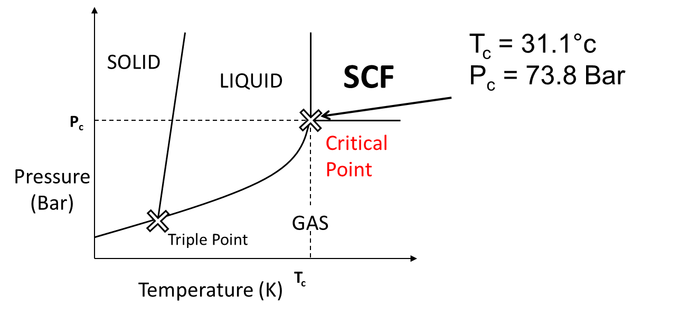
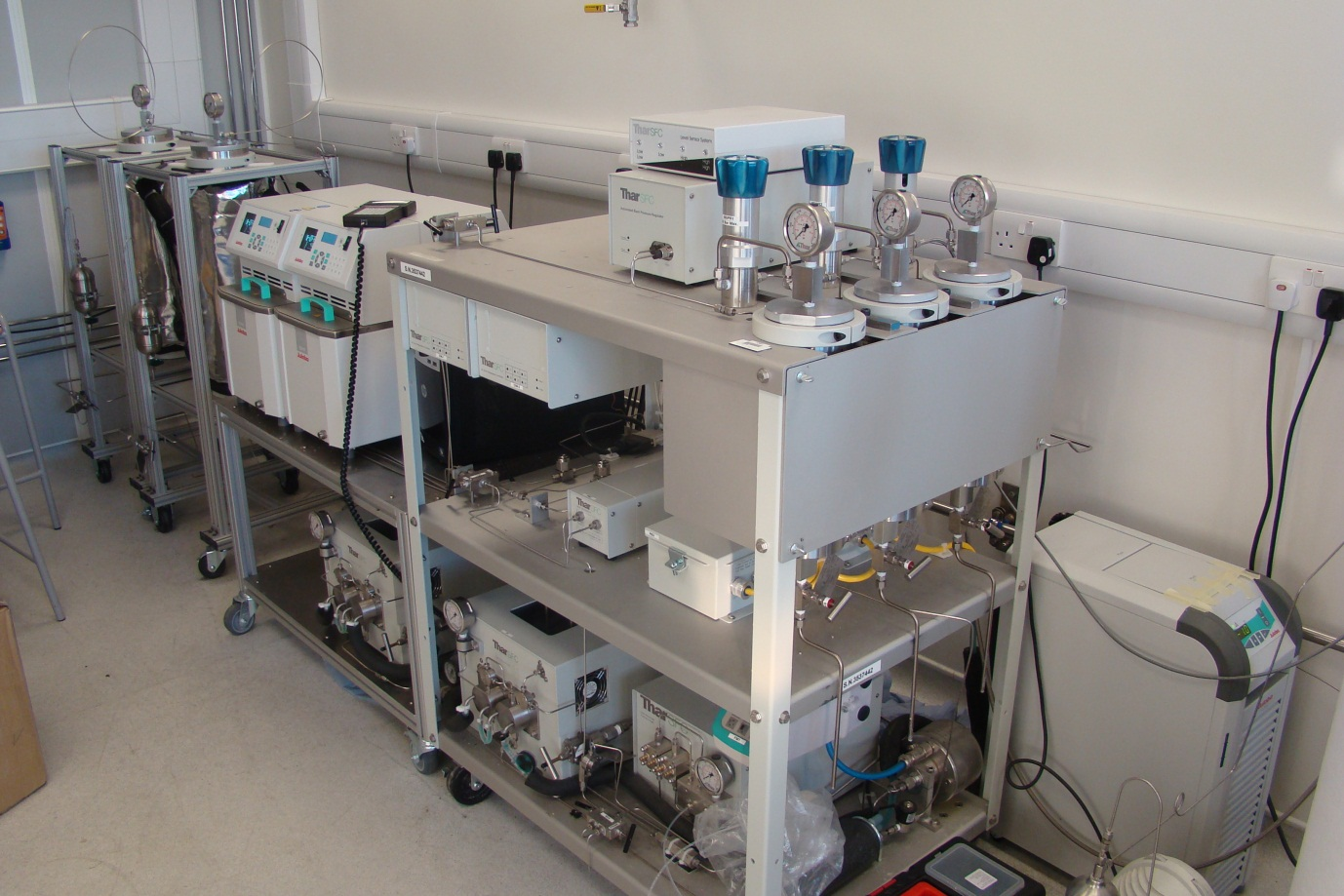
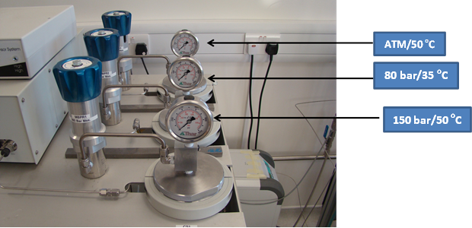
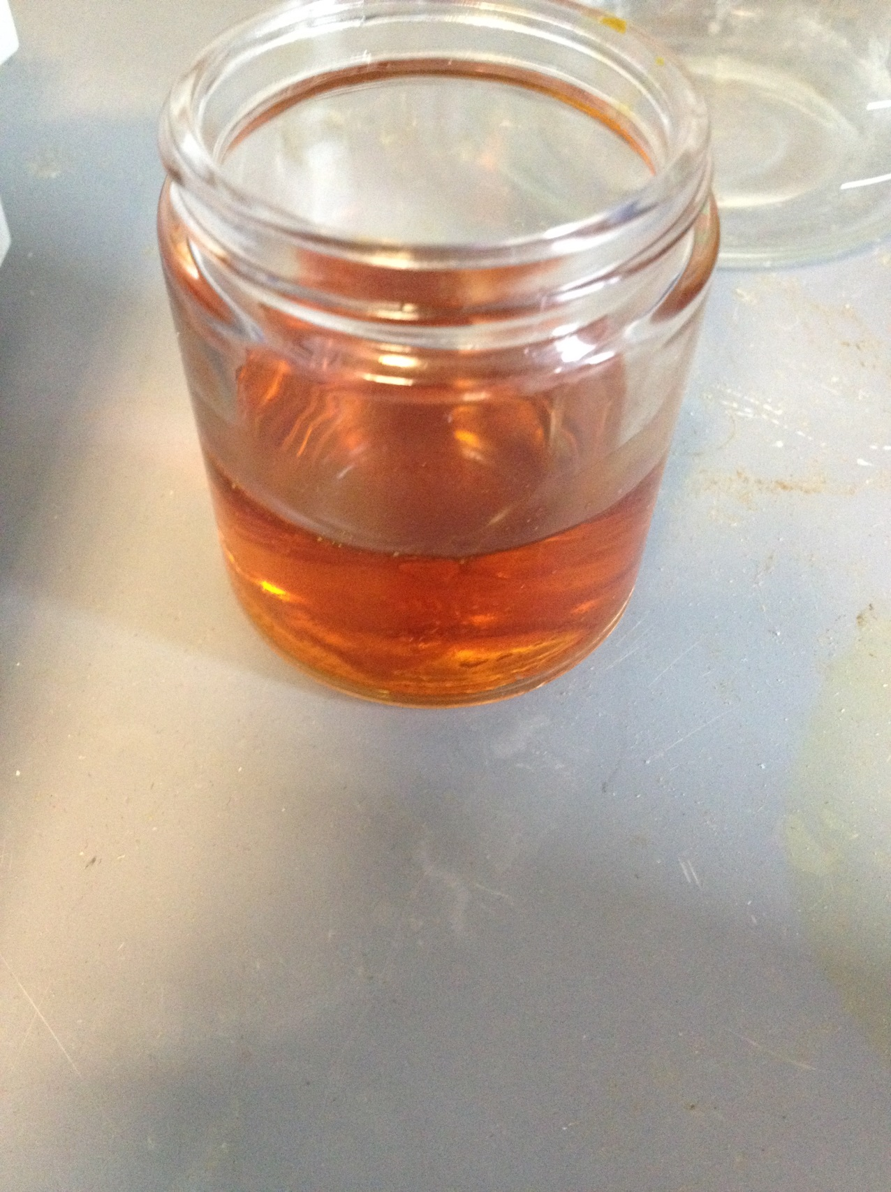
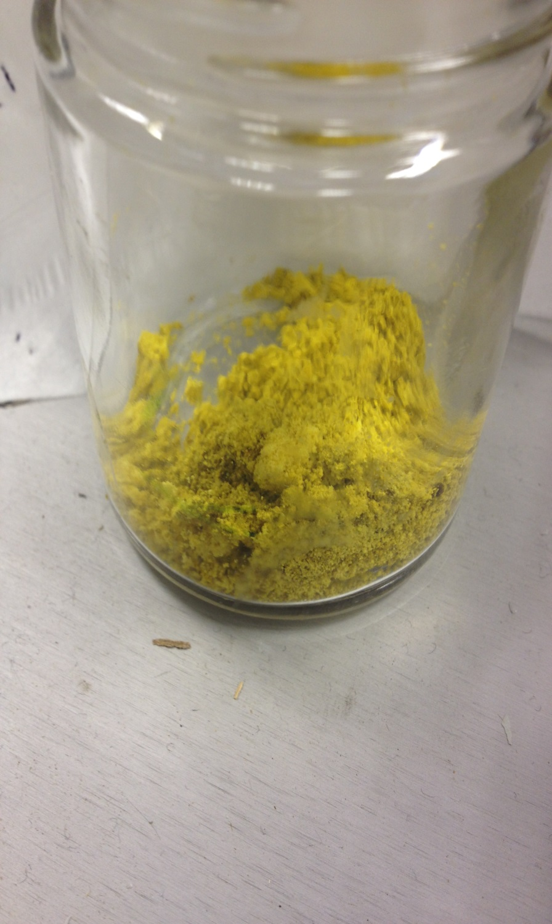
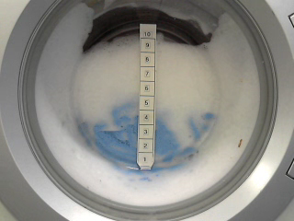
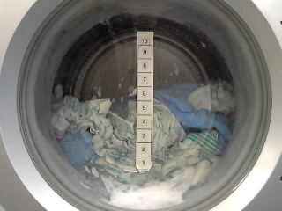
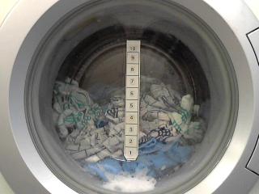
C4 Waxes as defoamers
Thomas M. Attard, Andrew J. Hunt and Elke Theeuwes
Since the 1990’s, decreasing fossil reserves, rising oil prices and concerns over security of supply and sustainability have led to a global policy shift back towards the use of biomass as a local, renewable and low carbon feedstock.
The biorefinery concept that has emerged is analogous to today’s petroleum refineries that convert the biomass into multiple value-added products including energy, chemical and materials.¹
Extraction of valuable phytochemicals, prior to more destructive processes, can significantly increase the range of products and potentially improve the overall financial returns.²
Supercritical Fluid Extraction/Fractionation of Waxes
The conventional techniques for extracting waxes involve the use of volatile organic solvents such as dichloromethane, chloroform and hexane which, apart from having environmental and toxicological effects, are also unselective and extract a number of unwanted compounds.³ Supercritical CO2 has several distinct advantages over conventional organic solvents in extractions.
Selective
Low surface tension
High mass transfer rates
Simple product recovery
No solvent residues
Cheap and non-toxic³
Waxes from maize and sugarcane bagasse contain a wide range of hydrophobic molecules ranging from long-chain hydrocarbons to wax esters.
Alkanes (Only odd numbered, mainly C₂₇, C₂₉ and C₃₁)
Fatty aldehydes (Mainly C26 to C34)
Wax esters (Mainly C₄₄, only even numbered, mainly formed with hexadecanoic acid or octacosanol)
Fatty Acids (Mainly even numbered, predominately C₁₆ and C₁₈ with different degrees of unsaturation)
Fatty Alcohols (Only even numbered, mainly C₂₄, C₂₆ and C₂₈)
Extractions of waxes from maize and sugarcane bagasse (SCB) were carried out using optimised conditions obtained using the factorial experimental design. Fractionation of crude waxes isolates different groups of hydrophobic molecules, resulting in wax fractions having distinct properties and melting points.
ATM/50 ºC – Maize wax is a liquid at 50 ºC
80 bar/35 ºC – Maize wax is a yellow powder
Sterols (cholesterol, campesterol, stigmasterol and sitosterol)
Defoaming Properties of waxes
Foam control in laundry applications
Foam control in horizontal axis washing machines is an important issue. Due to the mechanical agitation, elevated temperature and high surfactant concentration, an excess of foam can be generated resulting in adverse effects on washing performance related to impaired movement of the laundry itself and inefficient rinsing and drainage of the machine. Besides that, the electronic parts of the washing machine may be damaged. Several types of antifoam substances are used for foam control, although they have a negative impact on the environment^{4,5}: phosphates (eutrophication), nitrogen-containing compounds (possible carcinogenetic by-products nitrosamines), organic silicon compounds (persistent) and fluoro compounds. At the moment, carboxylates are used in ecological laundry detergents. Another option is renewable hydrocarbons, like waxes, as presented here. The waxes should have a melting point range between 30-50°C and low saponification values⁵.
Washing Machine Tests (real-life situation)
The wax samples were tested in the washing machine formulations. In the reference blank test no defoaming agent was added
while in the wax washing machine test wax was added to investigate its defoaming properties in a washing machine run.
The height of the foam was measured every 5 minutes in order to investigate the efficiency of the wax as a defoaming agent.
Reference Blank
Sugarcane
Maize
Conclusions
References
Waxes from maize and sugarcane bagasse have been successfully extracted and fractionated using supercritical carbon dioxide. Washing machine tests have shown that the waxes are promising antifoaming agents. Tests on the performance of the surfactants in the presence of the waxes will be carried out.
V. L. Budarin, P. S. Shuttleworth, J. R. Dodson, A. J. Hunt, B. Lanigan, R. Marriott, K. J. Milkowski, A. J. Wilson, S. W. Breeden, J. Fan, E. H. K. Sin and J. H. Clark, Energy & Environmental Science,2011, 4, 471-479.
J. H. Clark, V. Budarin, F. E. I. Deswarte, J. J. E. Hardy, F. M. Kerton, A. J. Hunt, R. Luque, D. J. Macquarrie, K. Milkowski, A. Rodriguez, O. Samuel, S. J. Tavener, R. J. White and A. J. Wilson, Green Chemistry, 2006, 8, 853-860.
F. E. I. Deswarte, J. H. Clark, J. J. E. Hardy and P. M. Rose, 2006, Green Chemistry, 8, 39-42.
http://ec.europa.eu/environment/ecolabel/documents/did_list/didlist_part_a_en.pdf
H. Ferch and W. Leonhardt. Foam Control in Detergent Products. In Defoaming Theory and Industrial Applications edited by P.R. Garrett, 1993, 221-268.

